Slide 1
User Datagram Program (UDP)
TCP/IP Protocol Suite
Copyright © The McGraw-Hill Companies, Inc. Permission required for reproduction or display.

Slide 2
14-1 INTRODUCTION
UDP is located between the application layer and the IP layer, and serves as the intermediary between the application programs and the network operations.
TCP/IP Protocol Suite

Slide 3
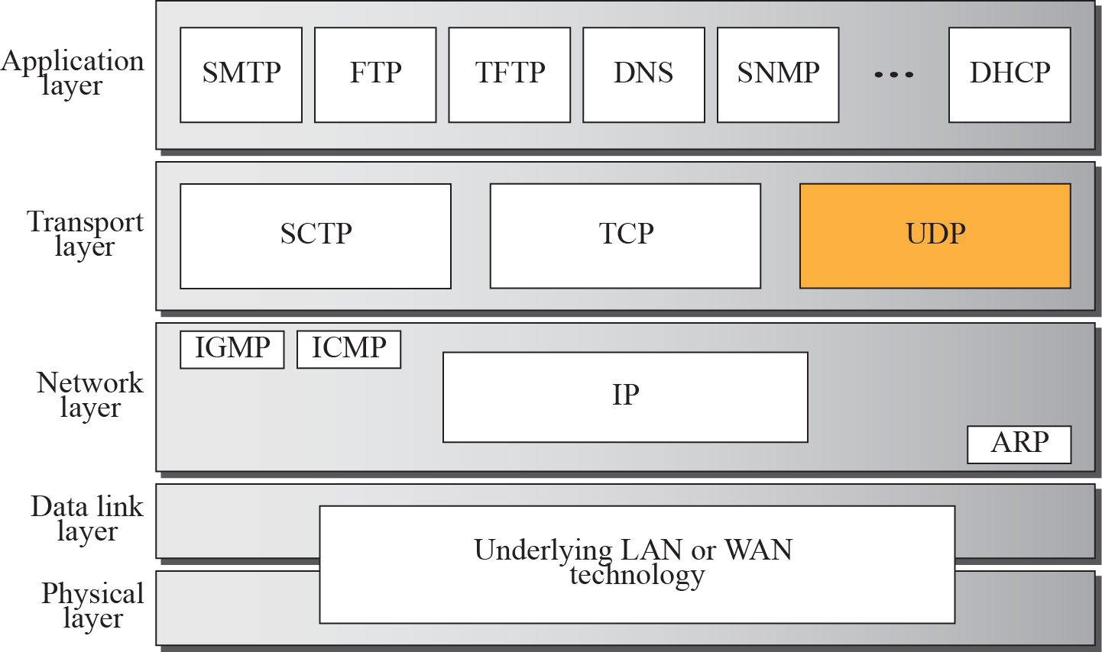
Figure 14.1 Position of UDP in the TCP/IP protocol suite
TCP/IP Protocol Suite

Slide 4
Figure 14.1 Position of UDP in the TCP/IP protocol suite
UDP is a connectionless, unreliable transport protocol.
It does not add anything to the services of IP except for providing process-to-process communication instead of host-to-host communication.
UDP is a very simple protocol using a minimum of overhead.
If a process wants to send a small message and does not care much about reliability, it can use UDP.
Sending a small message using UDP takes much less interaction between the sender and receiver than using TCP.
TCP/IP Protocol Suite

Slide 5
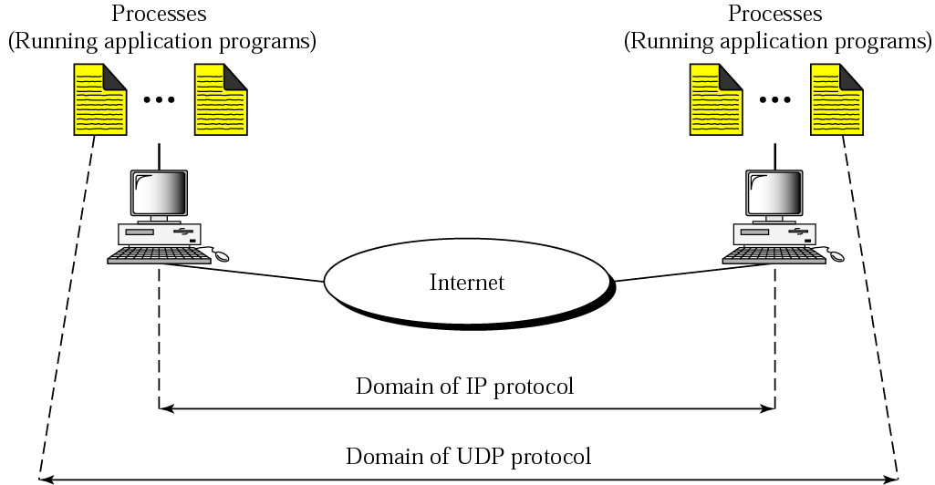
Figure 14.1 Position of UDP in the TCP/IP protocol suite
Process-to-Process Communication
TCP/IP Protocol Suite

Slide 6
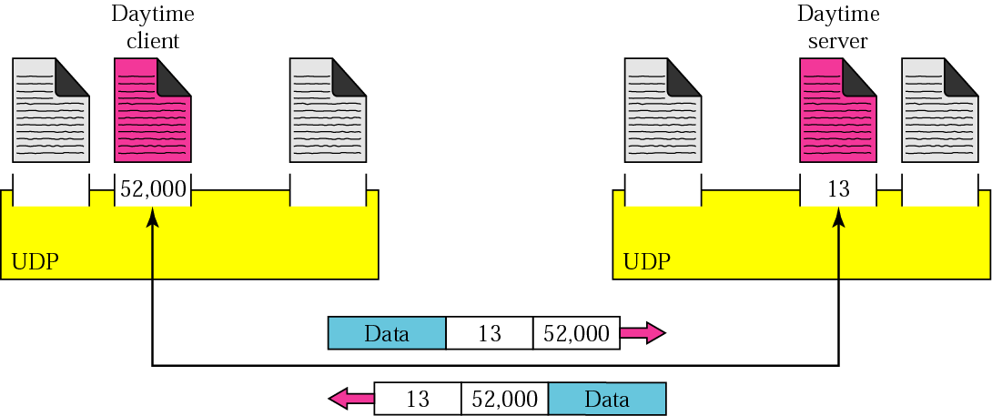
Figure 14.1 Position of UDP in the TCP/IP protocol suite
Port Numbers
TCP/IP Protocol Suite

Slide 7
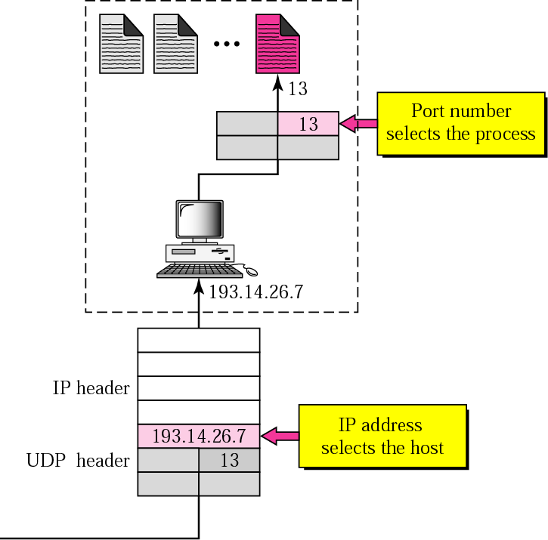
Figure 14.1 Position of UDP in the TCP/IP protocol suite
IP Address vs Port Numbers
TCP/IP Protocol Suite

Slide 8
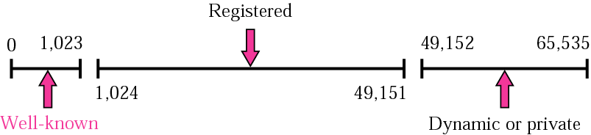
Figure 14.1 Position of UDP in the TCP/IP protocol suite
ICANN Port Number Ranges
The well-known port numbers are less than 1024.
TCP/IP Protocol Suite

Slide 9
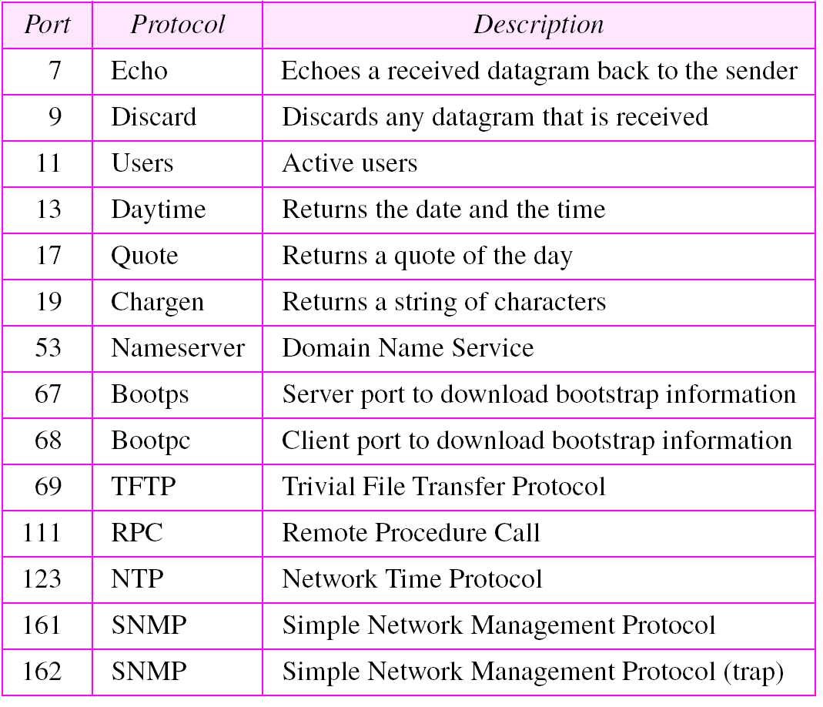
Figure 14.1 Position of UDP in the TCP/IP protocol suite
Well-known Ports used with UDP
TCP/IP Protocol Suite

Slide 10
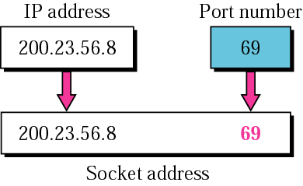
Figure 14.1 Position of UDP in the TCP/IP protocol suite
Socket Address
The combination of an IP address and Port number is called a socket address.
client socket address defines the client process
server socket address defines the server process.
72
72
TCP/IP Protocol Suite

Slide 11
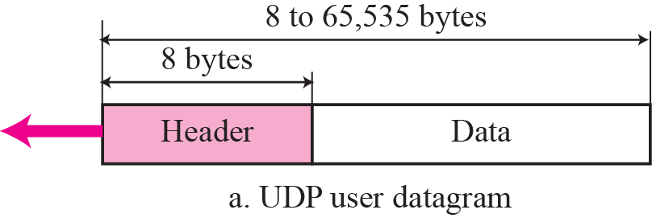
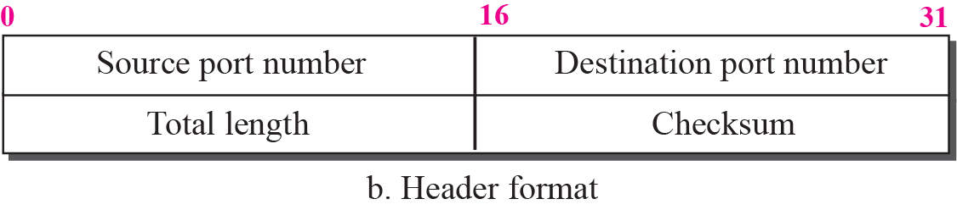
14-2 USER DATAGRAM
UDP packets, called user datagrams, have a fixed-size header of 8 bytes.
TCP/IP Protocol Suite

Slide 12
Source port number.
If the source host is the client (a client sending a request), the port number, in most cases, is an ephemeral port number.
If the source host is the server (a server sending a response), the port number, is a well-known port number.
Destination port number.
If the destination host is the server (a client sending a request), the port number, is a well-known port number.
If the destination host is the client (a server sending a response), the port number, is an ephemeral port number.
TCP/IP Protocol Suite

Slide 13
Length.
Defines the total length of the user datagram, header plus data.
The 16 bits can define a total length of 0 to 65,535 bytes.
However, the total length needs to be much less because a UDP user datagram is stored in an IP datagram with the total length of 65,535 bytes.
The length field in a UDP user datagram is actually not necessary.
IP datagram that defines a field for IP length − IP header’s length
UDP length = IP length − IP header’s length
TCP/IP Protocol Suite

Slide 14
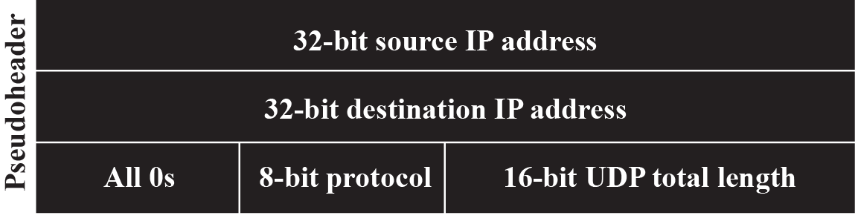
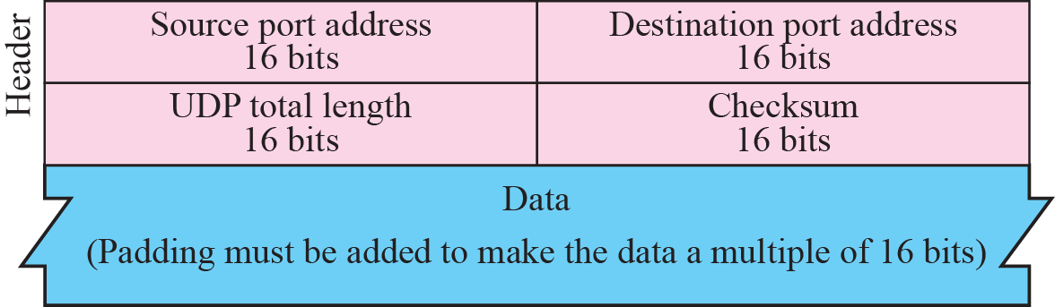
Checksum
Used to detect errors over the entire user datagram (header plus data).
UDP checksum calculation is different from the one for IP.
Checksum includes 3 sections: a pseudoheader, UDP header, and data coming from the application layer.
pseudoheader is the part of the header of the IP packet in which the user datagram is to be encapsulated with some fields filled with 0s.
TCP/IP Protocol Suite

Slide 15
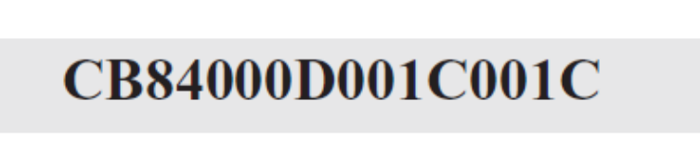
Example 14.1
The following is a dump of a UDP header in hexadecimal format.
a. What is the source port number?
b. What is the destination port number?
c. What is the total length of the user datagram?
d. What is the length of the data?
e. Is the packet directed from a client to a server or vice versa?
f. What is the client process?
TCP/IP Protocol Suite

Slide 16
Example 14.1 Continued
Solution
a. The source port number is the first four hexadecimal digits (CB84)₁₆ or 52100.
b. The destination port number is the second four hexadecimal digits (000D)₁₆ or 13.
c. The third four hexadecimal digits (001C)₁₆ define the length of the whole UDP packet as 28 bytes.
d. The length of the data is the length of the whole packet minus the length of the header, or 28 – 8 = 20 bytes.
e. Since the destination port number is 13 (well-known port), the packet is from the client to the server.
f. The client process is the Daytime (Table 14.1).
TCP/IP Protocol Suite

Slide 17
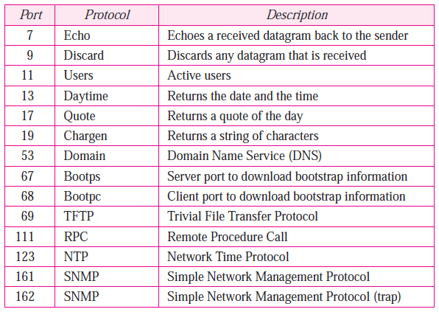
Example 14.1 Continued
Table 14.1 Well-known Ports used with UDP
TCP/IP Protocol Suite

Slide 18
14-3 UDP Services
services are provided by UDP.
Process-to-Process Communication
Connectionless Service
Flow Control
Error Control
Congestion Control
Encapsulation and Decapsulation
Multiplexing and Demultiplexing
TCP/IP Protocol Suite

Slide 19
Process-to-Process Communication
UDP provides process-to-process communication using sockets, a combination of IP addresses and port numbers.
TCP/IP Protocol Suite

Slide 20
Connectionless Services
Each user datagram sent by UDP is an independent datagram.
There is no relationship between the different user datagrams even if they are coming from the same source process and going to the same destination program.
The user datagrams are not numbered.
There is no connection establishment and no connection termination as is the case for TCP.
This means that each user datagram can travel on a different path.
TCP/IP Protocol Suite

Slide 21
Flow Control
There is no flow control, and hence no window mechanism.
The receiver may overflow with incoming messages.
Error Control
There is no error control mechanism in UDP except for the checksum.
Sender does not know if a message has been lost or duplicated.
When the receiver detects an error through the checksum, the user datagram is silently discarded.
Congestion Control
Does not provide congestion control.
TCP/IP Protocol Suite

Slide 22
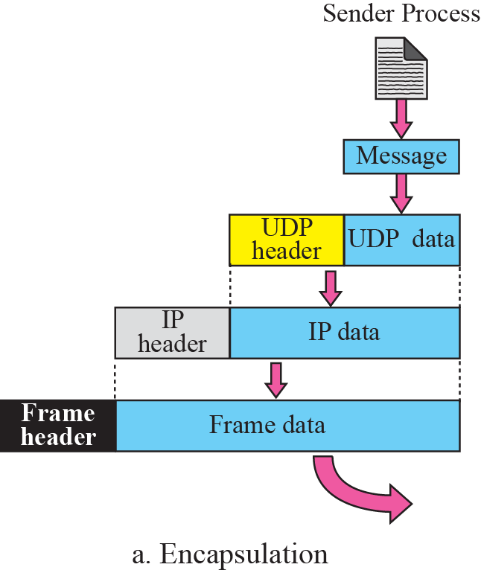
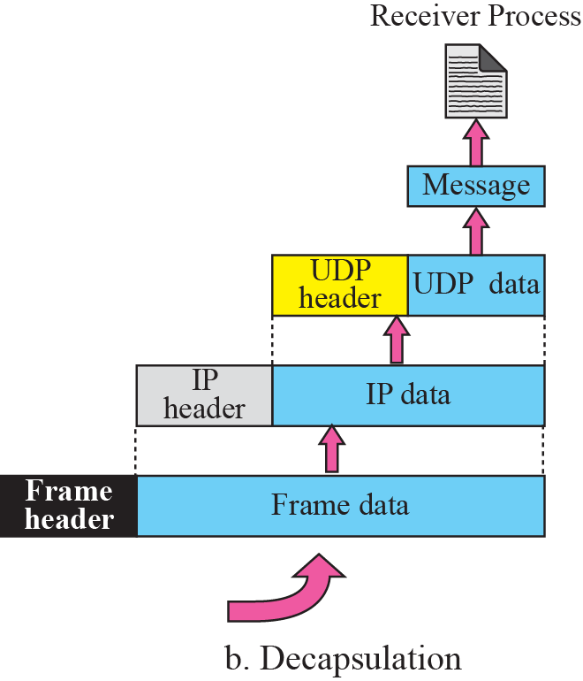

Figure 14.5 Encapsulation and decapsulation
Encapsulation and Decapsulation
To send a message from one process to another, the UDP protocol encapsulates and decapsulates messages.
TCP/IP Protocol Suite

Slide 23
Encapsulation
When a process has a message to send through UDP, it passes the message to UDP along with a pair of socket addresses and the length of data.
UDP receives the data and adds the UDP header. UDP then passes the user datagram to IP with the socket addresses.
IP adds its own header, using the value 17 in the protocol field, indicating that the data has come from the UDP protocol.
The IP datagram is then passed to the data link layer.
The physical layer encodes the bits into electrical or optical signals and sends it to the remote machine.
TCP/IP Protocol Suite

Slide 24
Decapsulation
When the message arrives at the destination host, the physical layer decodes the signals into bits and passes it to the data link layer.
The data link layer uses the header (and the trailer) to check the data.
If there is no error, the header and trailer are dropped and the datagram is passed to IP.
The IP software does its own checking. If there is no error, the header is dropped and the user datagram is passed to UDP with the sender and receiver IP addresses.
UDP uses the checksum to check the entire user datagram. If there is no error, the header is dropped and the application data along with the sender socket address is passed to the process.
The sender socket address is passed to the process in case it needs to respond to the message received
TCP/IP Protocol Suite

Slide 25
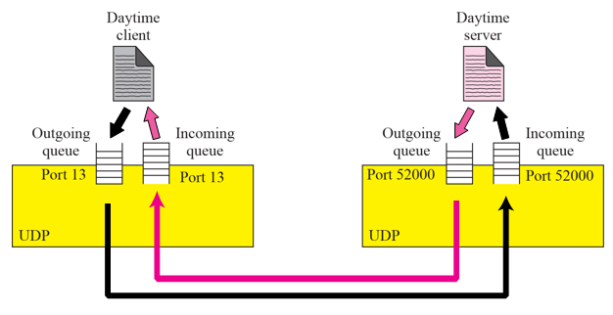
Queuing
In UDP, queues are associated with ports.
At the client site, when a process starts, it requests a port number from the operating system.
create incoming and an outgoing queue associated with each process.
When the process terminates, the queues are destroyed.
TCP/IP Protocol Suite

Slide 26
Queuing (contd)
The client process can send messages to the outgoing queue by using the source port number specified in the request.
An outgoing queue can overflow. If this happens, the operating system can ask the client process to wait before sending any more messages.
When a message arrives for a client, UDP sends the received user datagram to the end of the queue.
An incoming queue can overflow. If this happens, UDP drops the user datagram and asks for a port unreachable message to be sent to the server.
TCP/IP Protocol Suite

Slide 27
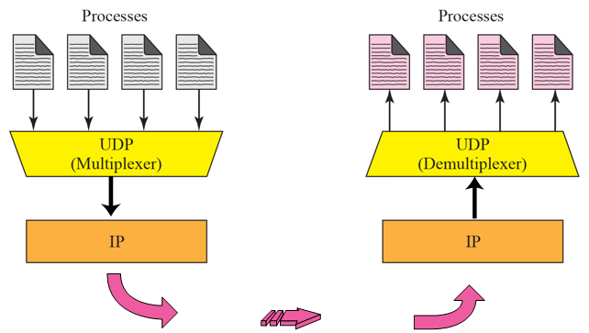
Figure 14.7 Multiplexing and demultiplexing
Multiplexing and Demultiplexing
In a host running a TCP/IP protocol suite, there is only one UDP but possibly several processes that may want to use the services of UDP.
To handle this situation, UDP multiplexes and demultiplexes.
TCP/IP Protocol Suite

Slide 28
Figure 14.7 Multiplexing and demultiplexing
Multiplexing and Demultiplexing
Multiplexing
At the sender site, there may be several processes that need to send user datagrams.
UDP accepts messages from different processes, differentiated by their assigned port numbers. After adding the header, UDP passes the user datagram to IP.
Demultiplexing
At the receiver site, there is only one UDP.
However, we may have many processes that can receive user datagrams. This is a one-to-many relationship and requires demultiplexing.
UDP receives user datagrams from IP. After error checking and dropping of the header, UDP delivers each message to the appropriate process based on the port numbers.
TCP/IP Protocol Suite

Slide 29
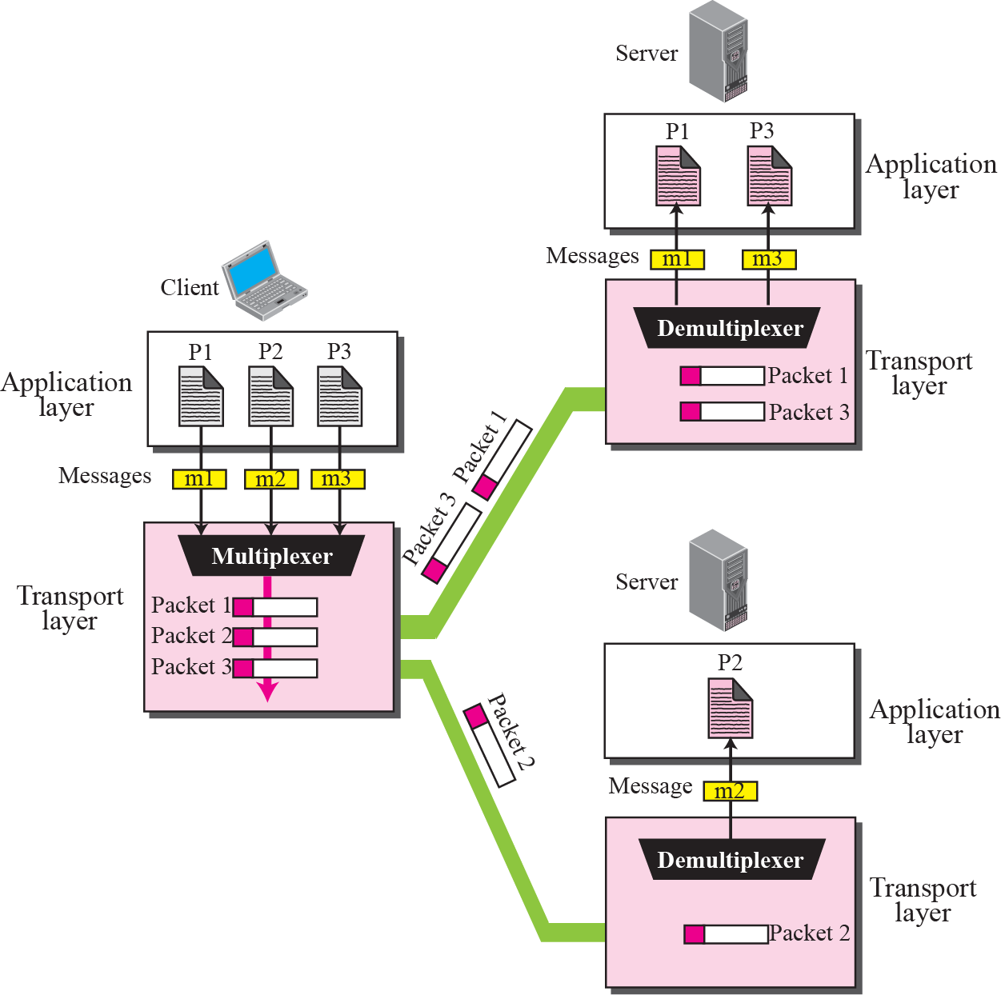
Figure 14.7 Multiplexing and demultiplexing
Multiplexing and Demultiplexing
TCP/IP Protocol Suite

Slide 30
14-4 UDP APPLICATION
UDP is suitable if the request and response can each fit in one single user datagram,
The overhead to establish and close a connection may be significant in this case.
In the connection-oriented service at least 9 packets are exchanged.
in connectionless service only two packets are exchanged.
The connectionless service provides less delay;
If delay is an important issue for the application, the connectionless service is preferred.
DNS uses the services of UDP because request and response can each fit in one user datagram
TCP/IP Protocol Suite

Slide 31
A client-server application such as SMTP, which is used in electronic mail, cannot use the services of UDP because a user can send a long e-mail message, which may include multimedia (images, audio, or video).
Here the connectionless service may create problems. The user datagrams may arrive and be delivered to the receiver application out of order.
.
TCP/IP Protocol Suite

Slide 32
Example 14.6
Downloading a very large text file from the Internet.
Need to use a transport layer that provides reliable service.
We don’t want part of the file to be missing or corrupted when we open the file.
In this case, UDP is not a suitable transport layer.
TCP/IP Protocol Suite

Slide 33
Typical Applications
some typical applications that can benefit more from the services of UDP than from those of TCP.
UDP is suitable for a process that requires simple request-response communication with little concern for flow and error control. It is not usually used for a process such as FTP that needs to send bulk data.
UDP is suitable for a process with internal flow and error-control mechanisms. For example, the Trivial File Transfer Protocol (TFTP) process includes flow and error control. It can easily use UDP.
UDP is a suitable transport protocol for multicasting. Multicasting capability is embedded in the UDP software but not in the TCP software.
UDP is used for management processes such as SNMP.
UDP is used for some route updating protocols such as Routing Information Protocol (RIP).
UDP is normally used for real-time applications that cannot tolerate uneven delay
between sections of a received message.
TCP/IP Protocol Suite

Slide 34
Questions
A client uses UDP to send data to a server. The data are 16 bytes. Calculate the efﬁciency of this transmission at the UDP level .
Redo the same question for calculating the efﬁciency of transmission at the IP level using IP.
TCP/IP Protocol Suite

Slide 35
Figure 14.1 Position of UDP in the TCP/IP protocol suite
Questions
1The following is a dump of a UDP header in hexadecimal form: 06 32 00 0D 00 1C E2 17
What is the:
(a)Source port number
(b) Destination port number
(c) Total length of the UDP
(d) Length of the data
2. What is the maximum number of bytes that can be accommodated as UDP payload?
TCP/IP Protocol Suite

Slide 36
END
TCP/IP Protocol Suite

